Slide 1
Safety Policy
An organization's safety policy is a recognized, written statement of its commitment to protect the health and safety of the employees and the surrounding community.
The safety policy also details the measures the company takes and will take to protect their employees' life, limb, and health, often surpassing the requirements set out by the laws or the standard practices of the industry.
The Occupational Health and Safety Act requires employers to develop and implement a safety policy.
To succeed, a safety policy requires commitment and endorsement from the employer and employee buy-in.
There are generally three sections in a safety policy, which include:
  Statement of the policy - The employer's commitment to managing health and safety and the goal of the policy
  Responsibility - Stating who is responsible for implementing, enacting, and tracking each element of the policy
  Arrangements or procedures - Outlines the details of procedures including the reduction of hazard policy

Slide 2
Safety Policy
It may also include details about the following:
  Employee training
  Use of administrative controls, hazard isolation, locking, warnings, signs and symbols marking hazards, etc.
  Use of personal protective equipment (PPE)
  Removing hazardous materials or replacing them with less harmful alternatives
  Improved lighting and working environment
  Prevention of slip, trip, and fall incidents

Slide 3
Safety Officer
A hundred things happen at once in an organization. And each of these activities needs to take place in a safe environment.
So, it’s crucial to have a person in your company who can recognize what could go wrong, act when something goes wrong, and be willing to take ownership of the situation.
This is where the role of a safety officer comes in.
The safety officer is an internal employee who is assigned to prevent accidents, respond to emergencies and evaluate the effectiveness of the company’s safety programs.
A safety officer identifies safety hazards, investigates them thoroughly, and controls them before someone gets hurt.

Slide 4
Safety Officer
The safety officer is the ‘head’ of the safety department and, in most organizations, reports to the Chief Operations Officer.
The safety officer also checks if the safety program is working effectively and efficiently to meet all requirements.
The role of a safety officer can vary from company to company, but they all have one thing in common — ensuring the safety of everyone in the workplace.
They verify that everyone on the site is following safe work practices and doing their jobs safely.

Slide 5
Qualifications of the safety professional
He should possess a recognized degree in any branch of engineering or technology or physics or chemistry and have sufficient practical experience of working
Possess a degree or diploma in industrial safety recognized by the Central Government.
Has adequate knowledge of the language spoken by majority of the workers in the industry which he has appointed.

Slide 6
Duties of safety officer
To advice the concerned departments in planning and organizing measures necessary for the effective control of personal injuries
To advice on safety aspects on all departmental work, and to carry out detailed job safety studies of selected work.
To check and evaluate the effectiveness of the action taken or proposed to be taken to prevent personal injuries
To advice purchasing and stores departments in ensuring high quality and availability of personal protective equipment
To carry out safety inspections of industry, in order to observe the physical conditions of work and the work practices and procedures followed by workers and to render advice on measures to be adopted for removing the unsafe physical conditions and preventing unsafe actions by workers.
To investigate the cases of occupational diseases contracted and reportable dangerous occurrences

Slide 7
Duties of safety officer
To advice maintenance of such records as are necessary relating to accidents, dangerous occurrences and occupational diseases.
To investigate fatal and other selected accidents
To promote setting up of safety committees and act as advisor and catalyst of such committees
To organise in association with the concerned departments, campaigns, competitions, contests and other activities which will develop and maintain the interest of the workers in establishing and maintaining safe conditions of work and procedures

Slide 8
Duties of safety officer
To design and conduct either independently or in collaboration with the training department, suitable training and educational programmes for the prevention of accidents to industrial workers.
Frame departmental safety rules and are working practices in consultation with the various departments or authorities
Supervise and guide in respect of safety precautions to be taken while handling dangerous operations

Slide 9
Safety Committee
A safety committee is an organization group that operates within a workplace and is composed of members from its various departments, including management, frontline workers, and office staff.
Safety committees bring together workers and employers through regularly scheduled meetings where safety issues are addressed. The goal of a safety committee is to create and nurture a culture of safety.
The main purpose of a safety committee is to mitigate the risk of workplace injuries and illnesses.
Its duties also include informing and educating employees about safety issues, setting achievable safety goals for the organization, and fostering a safety culture among the workforce

Slide 10
Safety Committee
Safety committees are typically formal arrangements that hold regular meetings, either weekly or monthly.
In smaller companies, however, it is common for the safety committee to gather all staff members for a monthly or quarterly safety meeting.
An effective safety committee should be large enough to broadly represent the workforce. It should include employees from all levels of the company, from the custodial staff to upper management.
Safety committee best practices include making sure that everyone has the opportunity to provide input, post questions, and raise concerns.

Slide 11
Functions of Safety Committee
Creating safety policies and developing written safety programs
Promoting safe work practices and enforcing of safety rules
Facilitating safety training
Inspecting the personal protection equipment (PPE)
Performing workplace inspections and measuring safety performance
Carrying out accident investigations
Acting as a point of contact between employees and management
Reviewing injury and illness records
Increasing awareness about workplace safety issues
Identifying hazards and recommending appropriate control measures

Slide 12


Slide 13
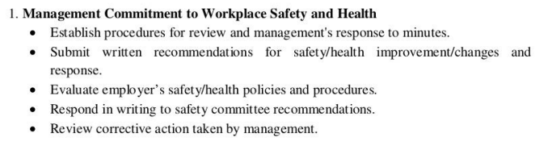

Slide 14
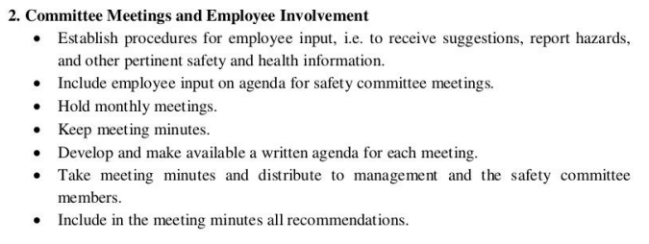

Slide 15
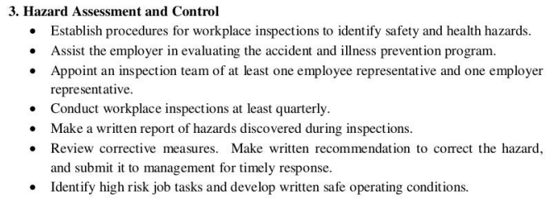

Slide 16
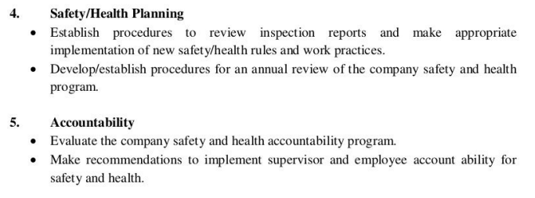

Slide 17
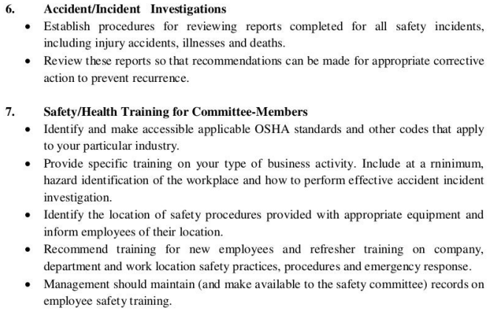

Slide 18
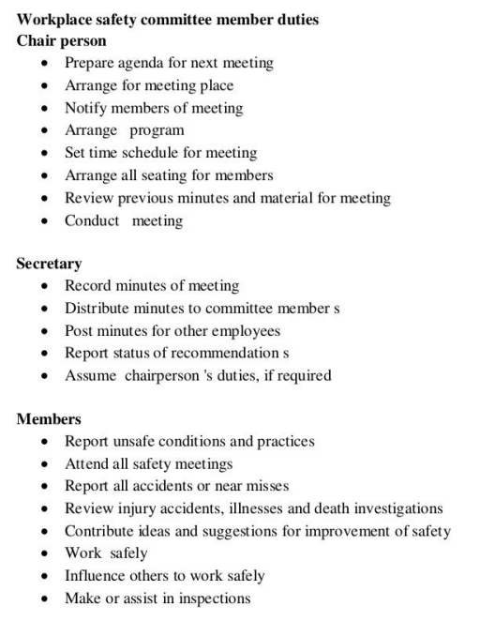

Slide 19
The Importance of Establishing a Safety Committee
Safety committees help provide an overall perspective of the safety status of the organization. It serves as a visible body that can be approached for safety or health complaints, suggestions, and other types of feedback.
As the committee solely deals with safety-related issues, it ensures that there are employees focused on and dedicated to coordinating safety-related activities. It also encourages and motivates employees to follow safety standards and signals to them that the organization is taking measures to protect their wellbeing.

